Slide 1
.
Mei Yang
University of San Diego
Deciphering Global Asia: A Poeticism of Disjuncture in Hou Hsiao-Hsien’s The Assassin
AACS, 2016
Notes:
To view this presentation, first, turn up your volume and second, launch the self-running slide show.

Slide 2
The Assassin (2015)
Hou Hsiao-Hsien’s first martial arts film
Based on a Tang chuanqi, “Nie Yinniang”
Dialogues in classical Chinese
A coproduction among Taiwan, Hong Kong and mainland China
A pan-Asian cast: Shu Qi,Chang Chen, Zhou Yun, Satoshi Tsumabuki
Trans-regional locations, from Kyoto to pristine China

Slide 3
Sight & Sound magazine ranked The Assassin as the best film of 2015 based on a poll of 168 critics from around the world. The Online Film Critics Society awarded the film as the best foreign language film of 2015.

Slide 4
Plot

Slide 5
A tale about Tang dynasty
A bygone time and a feel of nostalgia
rituals performed to perfection
immersion between human and nature
code of honor
A poeticism inspired by classical painting
negative space
the tranquil beauty of silence

Slide 6
Late Tang Dynasty as a still image

Slide 7
Rituals and formalities: reserved emotions

Slide 8
Rituals and formalities

Slide 9
Rituals and formalities

Slide 10
Tang everyday life

Slide 11
Family

Slide 12
Tang art and the Film: servant

Slide 13
Wearing flowers in front of a mirror

Slide 14
A lady playing zither

Slide 15
Human and nature

Slide 16
Human and nature

Slide 17
Poetics of painting: the elapse of time

Slide 18
Alternating and Evolving Perspectives
Alternating perceptions of realities: self and others, past and present

Slide 19
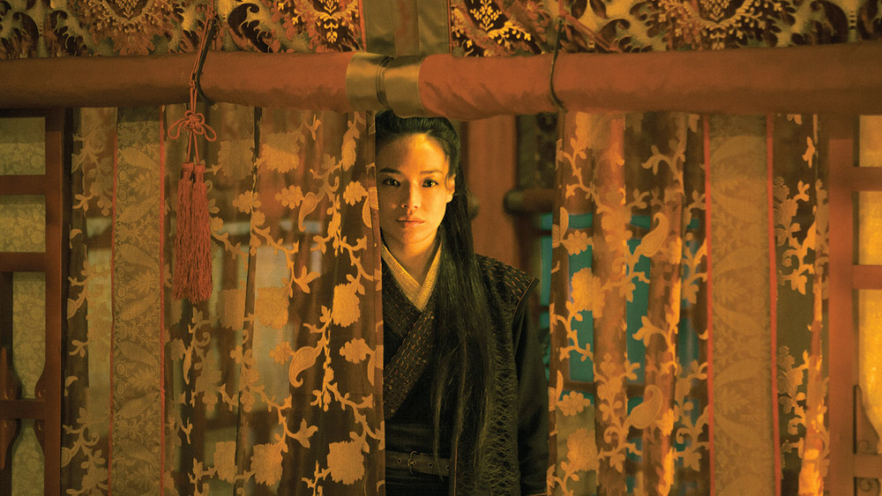
Nie Yinniang’s evolving point of view
the audience’s omnipresent perspective
both are challenged in the end
Notes:
To view this presentation, first, turn up your volume and second, launch the self-running slide show.

Slide 20
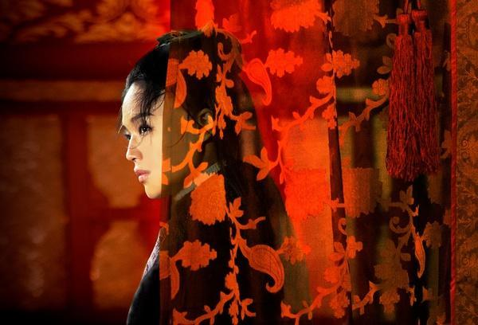
Nie Yinniang’s self discovery
the audience’s discovery of her childhood and her eventual decision
Notes:
To view this presentation, first, turn up your volume and second, launch the self-running slide show.

Slide 21
Her decision: “Not to Kill”

Slide 22
A tale about the miraculous and the magical change into a modern recount of humanism
When Nie Yinniang rejects her master’s order, she also overturns a storyline predetermined by a different temporality
Notes:
Presentations are a powerful communication medium.

Slide 23
Thesis
The film creates a space-time in the construct of Asia as a global locality that transcends geographical and temporal boundaries and reaches for universalistic appeal.

Slide 24
Global Asia: past and present
The mirror polisher played by Satoshi Tsumabuki came from Japan
At the end of the story, Nie Yinniang and the mirror polisher went to Silla (one of the Three Kingdoms of Korea, 57BC-935AD)

Slide 25
The global Asia in Hou’s films: Millennium Mambo (2001)

Slide 26
Film as the universalistic
between the medieval and the modern
Formalism, aestheticism, poeticism to retrieve the exquisite life of late Tang—historical accuracy
Thematic modification: no killing, sympathy, humane motive, rebellion about her master and become a helper

Slide 27
Universalistic, or not? Dissimilar values
the original story
The miraculous and mysterious
one person, without peer, unmatchable skills
the wondrous, the inhuman, a strange woman who is resolute, reclusive, and evading
the film
the humanistic
Between solitude and compassion
Become a rescuer who maintains social order
Return to a peaceful country life

Slide 28
In the story: Nie kills eagle

Slide 29
Ending in the story: Nie leaves alone

Slide 30
In the film: A daughter

Slide 31
A spouse: reestablishment of family and social order

Slide 32
Film criticisms
enigmatic, mesmerizing, puzzling
“part and parcel with its conception of a world of gestures and values so absolute as to be nearly unknowable.” (Ignatiy Vishnevetsky)
confusing
“these mysteries seem pointlessly and frustratingly obtuse, …not enough is done to bring the characters to life” (Sarah Cronin)

Slide 33
The poetics of disjuncture
The global oriental: codified but non-commoditized
As Nie walks away, a time of the past has left the audiences behind
Trance: the point is, we don’t know of that time
Silence, still scenes, the enigma
The feel of loss
A disconnect with the past
Disjuncture and connection
Temporal difference
Epistemological difference
identification with the protagonist
Identification with the film image
Melancholy and affirmation

Slide 34
“Alone, no peers”

